Slide 1
Summary on CD8-HP HiC-seq
Xiang Li
Apr, 2019
http://epigenomegateway.wustl.edu/legacy/?genome=mm9&session=wdq0ibJKuT&statusId=1132548014

Slide 2
Content Overview
0. Background Big Picture
1. Data & Quality Control
2. Alignment Information
3. Analysis
A. Appendix

Slide 3
Background Big Picture

Slide 4
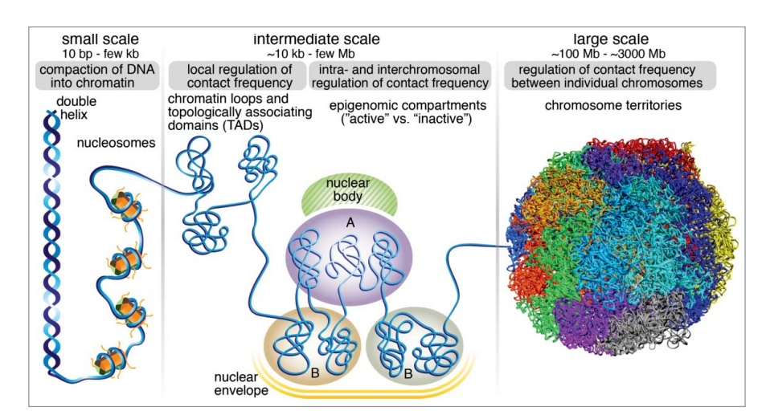
Ref: Recent evidence that TADs and chromatin loops are dynamic structures

Slide 5
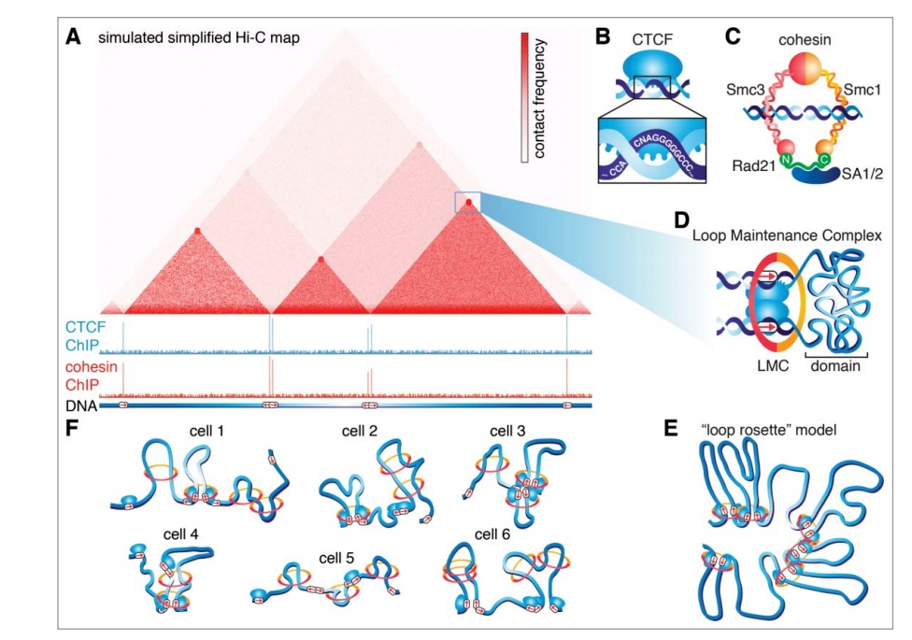
Ref: Recent evidence that TADs and chromatin loops are dynamic structures
Notes:
Another Ref: Visualizing DNA folding and RNA in embryos at single-cell resolution.

Slide 6
Ref: Targeted Degradation of CTCF Decouples Local Insulation of Chromosome Domains from Genomic Compartmentalization
Notes:
Ref: Targeted Degradation of CTCF Decouples Local Insulation of Chromosome Domains from Genomic Compartmentalization

Slide 7
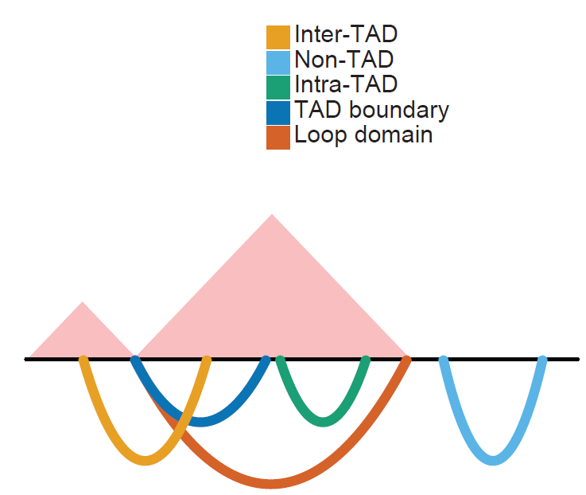

Slide 8
Code:
in directory: ZZeng/Data/Haihui/Tcf1/HiC-seq/Jul2017
& ZZeng/Data/Haihui/Tcf1/HiC-seq/Jul2017/iterative_mapping
Raw fastq
Iterative mapping
Python: run_iterative_mapping.py
Bash: run_iterative_mapping.sh
1)
Python: run_parse_sam.py
Bash: run_parse_sam.sh
Merge R1.bam R2.bam to Mapped Reads.hdf5
2)
Python: run_merge_pairs_and_rm_duplicates.py
Bash: run_merge_pairs_and_rm_duplicates.sh
Hiclib.
filterDuplicates(mode=u'auto', tmpDir=u'default', chunkSize=100000000)[source]
__optimized for large datasets__ removes duplicate molecules
Combine mapped reads into pairs and remove redundant pairs
ICE
Python: run_ICE.py
Bash: run_ICE.sh
Cooler.iterative_correction > output xx for Juicebox
Fit-hi-c
Python: sig_stat.py
Bash: run_fit-hi-c.sh
Fit-hi-c settings: bin size: 10 kb. Lower bound distance range: 20 kb. Upper bound distance range: 2 Mb
Juicebox
Bash: run_juicer_pre.sh
Genome browser
Python: generate_pairwise_interaction_bed12.py
Bash: generate_pairwise_interaction_bed12.sh
Script for associating differential expressed genes with stim increased / decreased interactions :
ZZeng/Data/Haihui/Tcf1/HiC-seq/Jul2017/iterative_mapping/analysis_for_stim_diff_genes.ipynb
Notes:
OUTPUT FILES AND THEIR FORMAT Each step of fit-hi-c, the number of which is user-defined through the -p flag, generates two output files. For step N and library name prefix denoted by ${PREFIX} the two output files will have the following names: 1- ${PREFIX}.fithic_passN.txt 2- ${PREFIX}.spline_passN.significances.txt.gz The first file will report the results of equal occupancy binning in five fields: "avgGenomicDist contactProbability standardError noOfLocusPairs totalOfContactCounts" 20077 2.38e-05 2.11e-06 210 19574 20228 1.88e-05 1.44e-06 268 19662 ... The second file will have the exact same lines as in the input file that contains the list of mid-range contacts. This input file had 5 fields as described above. The output from each step will append two more columns to these fields, namely p-value and q-value. "chr1 fragmentMid1 chr2 fragmentMid2 contactCount p-value q-value" 10 100695 10 127796 11 1.000000e+00 1.000000e+00 10 104051 10 229415 12 2.544592e-02 1.202603e-01 10 104051 10 231999 15 1.506105e-03 9.463644e-03 ...

Slide 9
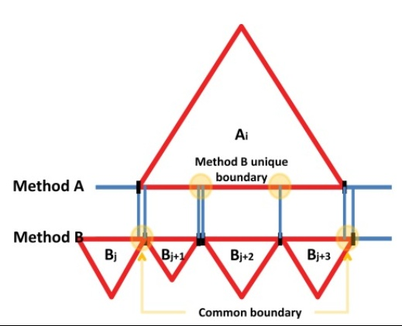
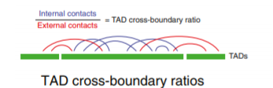
Diff TADs
1. Find common boundary and unique boundary, (bedtools) from TopDom.
2. TAD internal/ external interactions, using (SeqMonk http://www.bioinformatics.babraham.ac.uk/projects/seqmonk/)
2.b Identification of Opening and Closing TADs
3. Domain Score of TAD
Notes:
[2] TAD internal / external interactions “Read count” and “HiC read count” quantitations were used in SeqMonk (http://www.bioinformatics.babraham.ac.uk/projects/seqmonk/), using the selected TAD as a single probe. HiC read count ignores second read pair count if within the same window, so difference gives TAD-internal interactions. “4C other ends” data import was used to gather all ditag other ends from selected TAD. Read counts were generated for the remaining parts of the chromosome and all trans chromosomes. All values were normalised for total HiC read counts between samples.
[2.b]
Identification of Opening and Closing TADs Variation of the insulation of all TADs was calculated by assuming the true mean to be 0 (no difference between growing and senescence). Mean and difference between insulation scores were calculated for each point. Data was ordered by means and the standard deviation was calculated for each point using the 50 points ahead and behind it. Assuming the mean to be 0 and the data to have a normal distribution, p values were calculated using the pnorm function. Opening TADs were called by selecting only points with p < 0.05. As this cutoff did not select any closing TADs, a second cutoff (p < 0.25) was used and filtered for only closing TADs for comparison.
## From: Gangqing Transformation of Accessible Chromatin and 3D Nucleome Underlies Lineage Commitment of Early T Cells
[3] We followed others (Chandra et al., 2015) to define the domain score of a TAD as the ratio of the number of intra-TAD PETs to the
number of all TAD PETs. We observed that the domain score depends on TAD size, and therefore normalized the score by dividing
against the average of domain scores from 1000 simulated TAD of the same size randomly distributed across the same chromosome.
We further normalized the domain score of a TAD by subtracting the mean of all TADs, and applied quantile-normalization on domain
scores to facilitate comparison among all Hi-C libraries. We used ANOVA analysis to identify TADs with significant variability in
domain score across developmental stages from HSPC to DP cells (P-value with Bonferroni correction < 0.05).

Slide 10
Diff Compartments
Prediction of differential compartment
We predicted compartment flip by combining the change in the sign of compartment scores, variation in compartment scores among
replicates (Dixon et al., 2015) and dis-similarity of interaction profiles between genomic bins of 20kbp (Lin et al., 2012). We first identified
genomic bins with significant variability in compartment scores across all stages by using ANOVA analysis (p < 0.05). Then, we
considered only bins where all replicates showed changes in compartment scores from positive to negative or vice versa as candidates
of differential bins between any two stages (Dixon et al., 2015); in this analysis, we excluded genomic bins if any replicate-pair
from the two stages exhibited similar interaction profiles as determined from their correlation matrices by HOMER (P.C. > 0.6, an
indication of similar compartment status) (Lin et al., 2012). From the remaining candidates, we identified those that showed concordant
A-to-B compartment flip, namely such a flip occurred between at least two stages, but a B-to-A flip was absent between any two
stages, and similarly identified those that showed concordant B-to-A flip. Finally, we merged neighboring candidate bins that shared
the same flipping direction to identify genomic regions with concordant A-to-B or B-to-A compartment flip from HSPC to DP cells.

Slide 11
Part I Data & Quality Control

Slide 12
Data: CD8 Hi-C
Cell Type
WT CD8 | Two rounds of sequencing, technical replicates, combine them.
DKO CD8 | Two rounds of sequencing, technical replicates, combine them.
Stim WT CD8
Stim DKO CD8
DKO is Tcf1 Lef1 double knock out

Slide 13
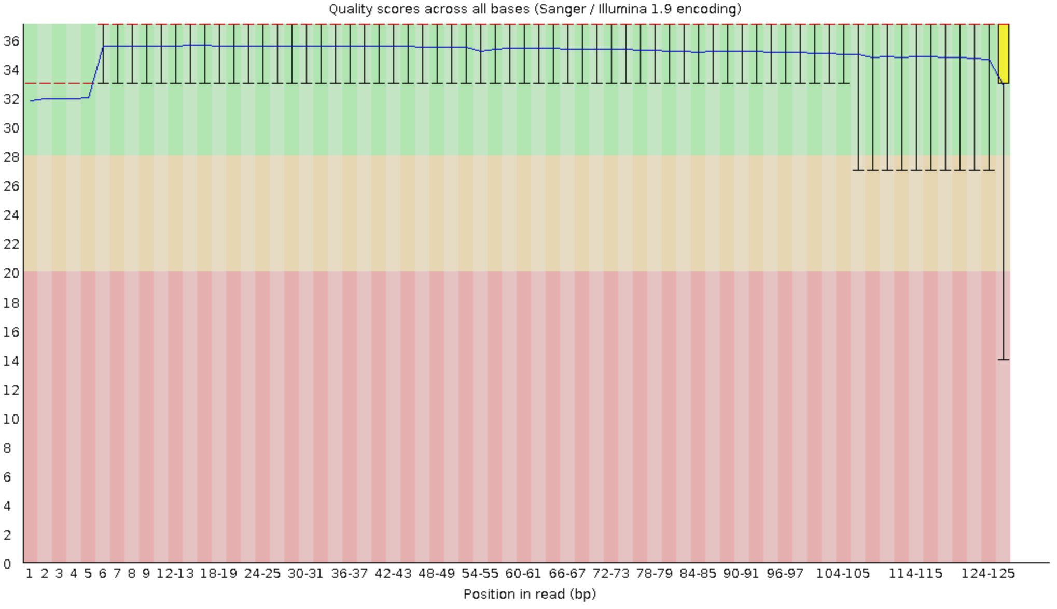
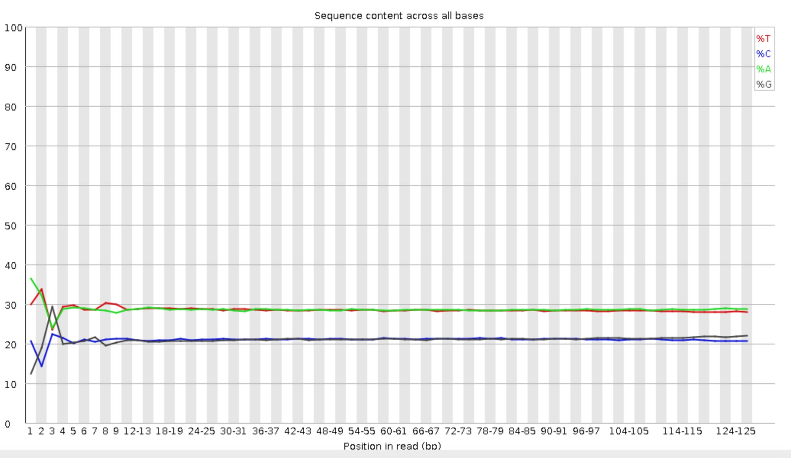
Sequence Quality
Sequence quality was assessed by FastQC
Sequence length: paired end, 126 bps
Sequence qualities of all samples are very good.
The first 4 bps have biased GC content. Tried trimming or non-trimming mapping before mapping and the mapping results have no difference. So in the downstream analysis, we will not trimmed at all.

Slide 14
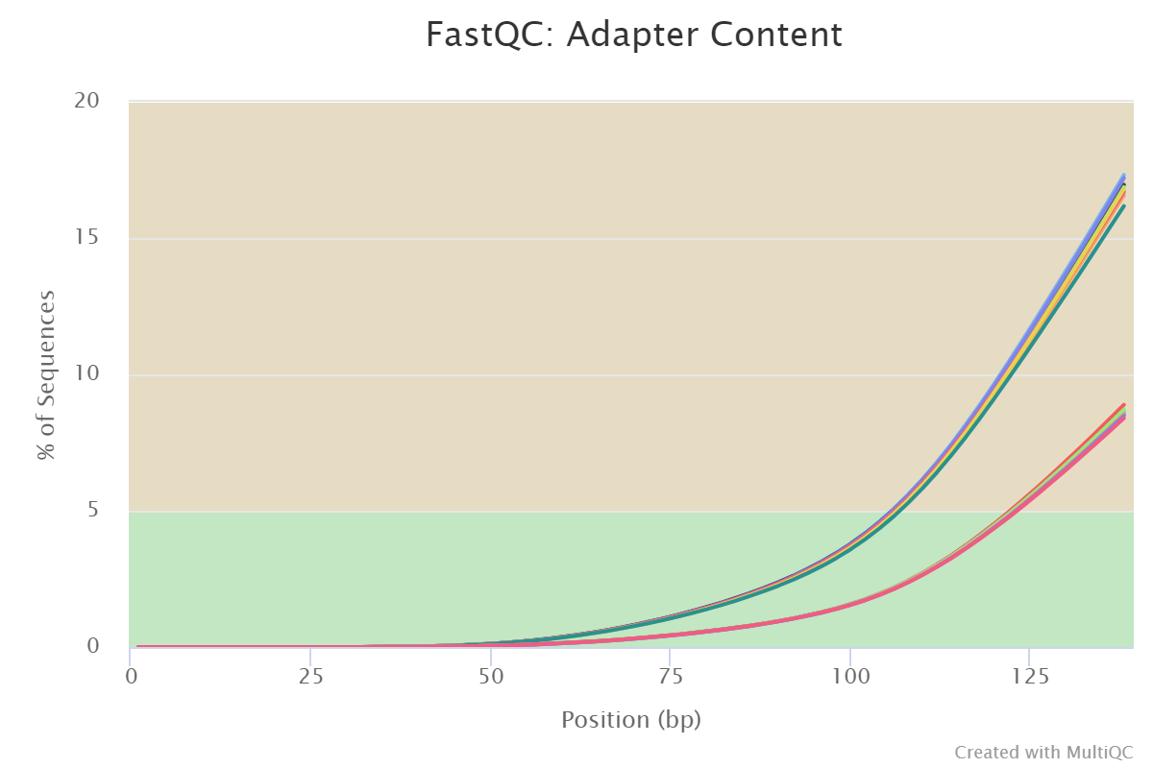
Sequence Quality
Trim -3 <Barcode> Restriction_Enzyme

Slide 15
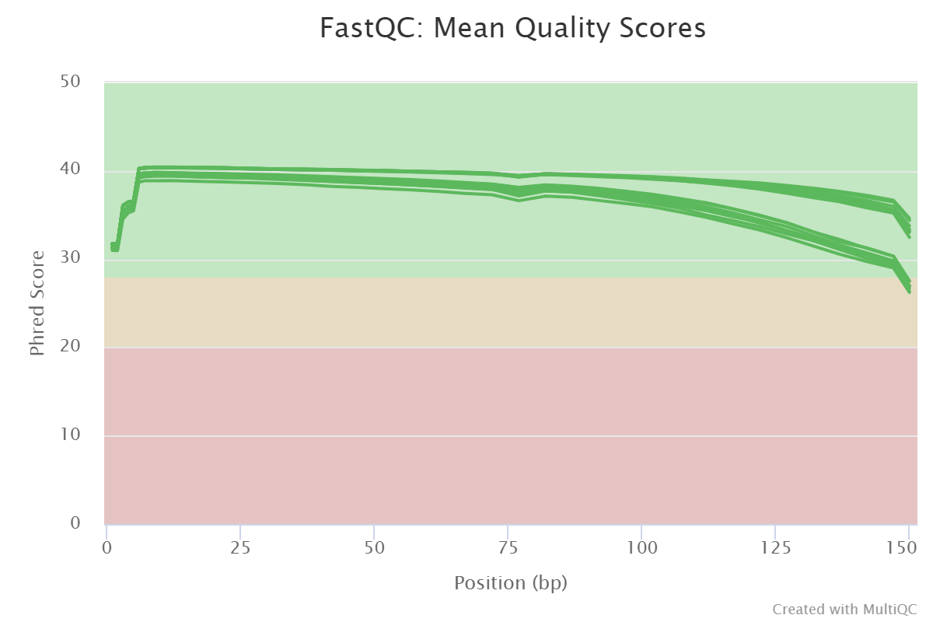
Sequence Quality Stim_WT_CD8 & Stim_DKO_CD8
Sequence quality was assessed by FastQC and multiqc
Sequence length: paired end, 151 bps
16 samples had less than 1% of reads made up of overrepresented sequences
Some libraries has bad quality after 100 bps.

Slide 16
Part II Alignment Information

Slide 17
Iterative mapping using Bowtie2
Bowtie2 was used to align the reads to mouse genome (UCSC mm9 from iGenome for gene annotation).
Iterative mapping algorithm (from hiclib): In this stage, we map two ends of reads in paired-end library individually 1.Truncate the sequences to the first 25 bps in 5’ end. 2.Map the sequences using bowtie2. 3.Store the uniquely mapped sequences. 4.Go to the step 1, increase the truncation length by 5 bps, and map the multiple-aligned sequences, ... Stop when truncated sequence reaches to 50/105 bps in length.

Slide 18
Iterative mapping using Bowtie2
WT CD8 R1
WT CD8 R2
# Round | # raw reads | # unique aligned reads | # multiple aligned reads
#1: 25 bps | 735,858,474 | 478412554 (65.01%) | 189414544 (25.74%)
#2: 30 bps | 191216188 | 20852554 (10.91%) | 164987032 (86.28%)
#3: 35 bps | 166024767 | 11052669 (6.66%) | 150671648 (90.75%)
#4: 40 bps | 151576090 | 9189678 (6.06%) | 138500020 (91.37%)
#5: 45 bps | 139262623 | 5832878 (4.19%) | 130507532 (93.71%)
#6: 50 bps | 131249079 | 4688873 (3.57%) | 123860163 (94.37%)
# Round | # raw reads | # unique aligned reads | # multiple aligned reads
#1: 25 bps | 735858474 | 469092348 (63.75%) | 186153326 (25.30%)
#2: 30 bps | 187785744 | 20378512 (10.85%) | 162097174 (86.32%)
#3: 35 bps | 163111654 | 10874544 (6.67%) | 147962621 (90.71%)
#4: 40 bps | 148917015 | 8952216 (6.01%) | 136013037 (91.33%)
#5: 45 bps | 136805600 | 5727979 (4.19%) | 128113448 (93.65%)
#6: 50 bps | 128869384 | 4606543 (3.57%) | 121553613 (94.32%)
First round gets 90.26% of unique aligned reads. 9.74% of unique aligned reads are mapped by iterative mapping (extra 5 rounds).
If running 17 rounds (from 25 bps to 105 bps), 5.85% more reads can be mapped (compared with 6 rounds).
First round gets 90.27% of unique aligned reads. 9.73% of unique aligned reads are mapped by iterative mapping (extra 5 rounds).
If running 17 rounds (from 25 bps to 105 bps), 5.81% more reads can be mapped (compared with 6 rounds).

Slide 19
Iterative mapping using Bowtie2
DKO CD8 R1
DKO CD8 R2
# Round | # raw reads | # unique aligned reads | # multiple aligned reads
#1: 25 bps | 773770652 | 500290481 (64.66%) | 200899206 (25.96%)
#2: 30 bps | 202797082 | 21888752 (10.79%) | 174956290 (86.27%)
#3: 35 bps | 176073467 | 11613254 (6.60%) | 159716039 (90.71%)
#4: 40 bps | 160722559 | 9662438 (6.01%) | 146693016 (91.27%)
#5: 45 bps | 147536331 | 6129336 (4.15%) | 138152630 (93.64%)
#6: 50 bps | 138973614 | 4942978 (3.56%) | 131001915 (94.26%)
# Round | # raw reads | # unique aligned reads | # multiple aligned reads
#1: 25 bps | 773770652 | 490268902 (63.36%) | 197511824 (25.53%)
#2: 30 bps | 199265155 | 21391633 (10.74%) | 171999521 (86.32%)
#3: 35 bps | 160803422 | 10628603 (6.61%) | 145773136 (90.65%)
#4: 40 bps | 146757052 | 8754279 (5.97%) | 133892932 (91.23%)
#5: 45 bps | 134704166 | 5596063 (4.15%) | 126050099 (93.58%)
#6: 50 bps | 126825865 | 4510654 (3.56%) | 119486001 (94.21%)
First round gets 90.22% of unique aligned reads. 9.77% of unique aligned reads are mapped by iterative mapping (extra 5 rounds).
If running 17 rounds (from 25 bps to 105 bps), 5.88% more reads can be mapped (compared with 6 rounds).
First round gets 90.60% of unique aligned reads. 9.40% of unique aligned reads are mapped by iterative mapping (extra 5 rounds).
If running 17 rounds (from 25 bps to 105 bps), 6.34% more reads can be mapped (compared with 6 rounds).

Slide 20
No need for Repeat Removal if carried out De-duplication
DKO CD8 R1
DKO CD8 R2
# Round | # of Total Reads | After Repeat Removal | After DUPLICATION Removal | After Dup repeat Removal
#1: 25 bps | 62,040,648 | 58,022,129 | 55,729,563 | 54,458,751
#3: 35 bps | 15,114,209 | 12,096,300 | 12,070,840 | 11,392,561
#5: 45 bps | 12,723,900 | 10,119,997 | 9,996,239 | 9,529,397
#1: 55 bps | 11,382,951 | 9,012,971 | 8,819,021 | 8,481,908
#2: 65 bps | 10,350,707 | 8,139,426 | 7,914,047 | 7,659,027
#3: 75 bps | 9,462,130 | 7,370,711 | 7,137,805 | 6,939,065
#4: 85 bps | 8,740,930 | 6,746,667 | 6,534,981 | 6,374,378
#5: 95 bps | 8,062,507 | 6,155,380 | 5,964514 | 5,830,855
#6: 105 bps | 7,462,036 | 5,630,652 | 5,457054 | 5,342,937
# Round | # of Total Reads | After Repeat Removal | After DUPLICATION Removal | After Dup repeat Removal
#1: 25 bps | 60,882,017 | 56,937,479 | 54,780421 | 53,533,555
#3: 35 bps | 14,868,021 | 11,897,971 | 11,895041 | 11,226,075
#5: 45 bps | 12,516,337 | 99,53,476 | 9,845826 | 9,388,484
#1: 55 bps | 11,191,888 | 8,859,431 | 8,678582 | 8,349,137
#2: 65 bps | 10,185,985 | 8,008,588 | 7,796098 | 7,546,666
#3: 75 bps | 9,318,103 | 7,257,598 | 7,036379 | 6,841,780
#4: 85 bps | 8,612,217 | 6,647,033 | 6,446279 | 6,288,414
#5: 95 bps | 7,949,361 | 6,069,997 | 5,888028 | 5,756,473
#6: 105 bps | 7,360,469 | 5,556,547 | 5,390101 | 5,277,934
Notes:
Picard was used for duplication removal.

Slide 21
Fit-Hic
3- Choose the number of steps that will be used to assign confidence estimates. For instance, if 3 is selected than initial spline fit (spline-1) plus 2 steps of refinement of the null model will be applied. Results from each step will be outputted in separate files. This will be passed with -p flag. Default value is 2. -p 3
Notes:
-p NOOFPASSES, --passes=NOOFPASSES OPTIONAL: number of passes after the initial (before) fit. DEFAULT is 1 (after)

Slide 22
Hi-C data analysis Procedures
WT CD8
Steps | Input | Output
1. Combine mapped reads into pairs (valid pairs require both ends are uniquely mapped with MAPQ ≥ 30) | # R1 mapped reads: 561,036,506 # R2 mapped reads: 549,841,390 | # valid read pairs: 404,008,692
2. Remove redundant pairs | # valid read pairs: 404,008,692 | # redundancy removed pairs: 363,178,026
DKO CD8
Steps | Input | Output
1. Combine mapped reads into pairs (valid pairs require both ends are uniquely mapped with MAPQ ≥ 30) | # R1 mapped reads: 587,155,558 # R2 mapped reads: 575,455,401 | # valid read pairs: 418,715,353
2. Remove redundant pairs | # valid read pairs: 418,715,353 | # redundancy removed pairs: 354,136,239
3. Generate whole-genome contact maps at 10 kb resolution, and performed Iterative Correction and Eigenvector Decomposition (ICE) normalization on the whole-genome contact maps

Slide 23
Fit-hi-c to find significant intra-chromosomal interactions
Fit-hi-c settings: bin size: 10 kb. Lower bound distance range: 20 kb. Upper bound distance range: 2 Mb
 | Possible intra-chr fragment pairs in range (after ICE normalization) | Observed intra-chr fragment pairs in range (have interaction read counts) | Significant intra-chr fragment pairs in range (q-value < 0.05) | Significant intra-chr fragment pairs in range (q-value < 1e-4) | Significant intra-chr fragment pairs in range (q-value < 1e-10)
WT CD8 | 47,610,090 | 19,168,048 | 3,619,684 | 1,462,917 | 572,801
DKO CD8 | 47,486,397 | 18,846,152 | 3,214,043 | 1,268,778 | 485,770

Slide 24
Iterative mapping using Bowtie2
Stim WT CD8 R1
Stim WT CD8 R2
# Round | # raw reads | # unique aligned reads | # multiple aligned reads
#1: 25 bps | 1274878501 | 859325242 (67.40%) | 349807617 (27.44%)
#2: 30 bps | 364273899 | 43119211 (11.84%) | 310273442 (85.18%)
#3: 35 bps | 316982820 | 27241855 (8.59%) | 283065580 (89.30%)
#4: 40 bps | 285539792 | 14128313 (4.95%) | 267469327 (93.67%)
#5: 45 bps | 269858664 | 13505011 (5.00%) | 252584476 (93.60%)
#6: 50 bps | 255104851 | 9582241 (3.76%) | 242159478 (94.93%)
# Round | # raw reads | # unique aligned reads | # multiple aligned reads
#1: 25 bps | 1274878501 | 842997383 (66.12%) | 347319028 (27.24%)
#2: 30 bps | 363063232 | 43323887 (11.93%) | 307484246 (84.69%)
#3: 35 bps | 315025826 | 26808868 (8.51%) | 280025608 (88.89%)
#4: 40 bps | 283064118 | 14204503 (5.02%) | 264338437 (93.38%)
#5: 45 bps | 267133010 | 13304539 (4.98%) | 249856653 (93.53%)
#6: 50 bps | 252796145 | 9786770 (3.87%) | 239467374 (94.73%)
# Round | fraction of unique aligned reads
First round (25 bps) | 83.04%
extra 5 rounds (30 bps – 50 bps) | 10.40%
Extra 11 rounds (55 bps – 105 bps) | 6.56%
# Round | fraction of unique aligned reads
First round (25 bps) | 82.62%
extra 5 rounds (30 bps – 50 bps) | 10.53%
Extra 11 rounds (55 bps – 105 bps) | 6.85%

Slide 25
Iterative mapping using Bowtie2
Stim DKO CD8 R1
Stim DKO CD8 R2
# Round | # raw reads | # unique aligned reads | # multiple aligned reads
#1: 25 bps | 1373981956 | 928792742 (67.60%) | 364216173 (26.51%)
#2: 30 bps | 381899346 | 47244243 (12.37%) | 321598623 (84.21%)
#3: 35 bps | 329586647 | 29495478 (8.95%) | 292241782 (88.67%)
#4: 40 bps | 295102390 | 15223028 (5.16%) | 275328160 (93.30%)
#5: 45 bps | 278084478 | 14559948 (5.24%) | 259132255 (93.18%)
#6: 50 bps | 262039170 | 10397174 (3.97%) | 247720802 (94.54%)
# Round | # raw reads | # unique aligned reads | # multiple aligned reads
#1: 25 bps | 1373981956 | 908440806 (66.12%) | 360370316 (26.23%)
#2: 30 bps | 378943410 | 47013635 (12.41%) | 317397294 (83.76%)
#3: 35 bps | 326357607 | 28847984 (8.84%) | 287839159 (88.20%)
#4: 40 bps | 291349642 | 15240658 (5.23%) | 270877747 (92.97%)
#5: 45 bps | 274092588 | 14157634 (5.17%) | 255346141 (93.16%)
#6: 50 bps | 258719636 | 10593742 (4.09%) | 244023127 (94.32%)
# Round | fraction of unique aligned reads
First round (25 bps) | 83.03%
extra 5 rounds (30 bps – 50 bps) | 10.45%
Extra 11 rounds (55 bps – 105 bps) | 6.52%
# Round | fraction of unique aligned reads
First round (25 bps) | 82.66%
extra 5 rounds (30 bps – 50 bps) | 10.54%
Extra 11 rounds (55 bps – 105 bps) | 6.80%

Slide 26
Hi-C data analysis Procedures
Stim WT CD8
Steps | Input | Output
1. Combine mapped reads into pairs (valid pairs require both ends are uniquely mapped with MAPQ ≥ 30) | # R1 mapped reads: 1,034,819,857 # R2 mapped reads: 1,020,372,388 | # valid read pairs: 819,093,448
2. Remove redundant pairs | # valid read pairs: 819,093,448 | # redundancy removed pairs: 522,175,096
Stim DKO CD8
Steps | Input | Output
1. Combine mapped reads into pairs (valid pairs require both ends are uniquely mapped with MAPQ ≥ 30) | # R1 mapped reads: 1,118,643,651 # R2 mapped reads: 1,099,022,238 | # valid read pairs: 850,748,197
2. Remove redundant pairs | # valid read pairs: 850,748,197 | # redundancy removed pairs: 526,108,938
3. Generate whole-genome contact maps at 10 kb resolution, and performed Iterative Correction and Eigenvector Decomposition (ICE) normalization on the whole-genome contact maps

Slide 27
Fit-hi-c to find significant intra-chromosomal interactions
Fit-hi-c settings: bin size: 10 kb. Lower bound distance range: 20 kb. Upper bound distance range: 2 Mb
 | Possible intra-chr fragment pairs in range (after ICE normalization) | Observed intra-chr fragment pairs in range (have interaction read counts) | Significant intra-chr fragment pairs in range (q-value < 0.05) | Significant intra-chr fragment pairs in range (q-value < 1e-4) | Significant intra-chr fragment pairs in range (q-value < 1e-10)
stim WT CD8 | 47,589,657 | 16,767,874 | 2,651,177 | 1,068,444 | 412,924
stim DKO CD8 | 47,754,939 | 19,379,489 | 3,792,847 | 1,640,168 | 689,500

Slide 28
Part III Analysis

Slide 29
TAD analysis

Slide 30
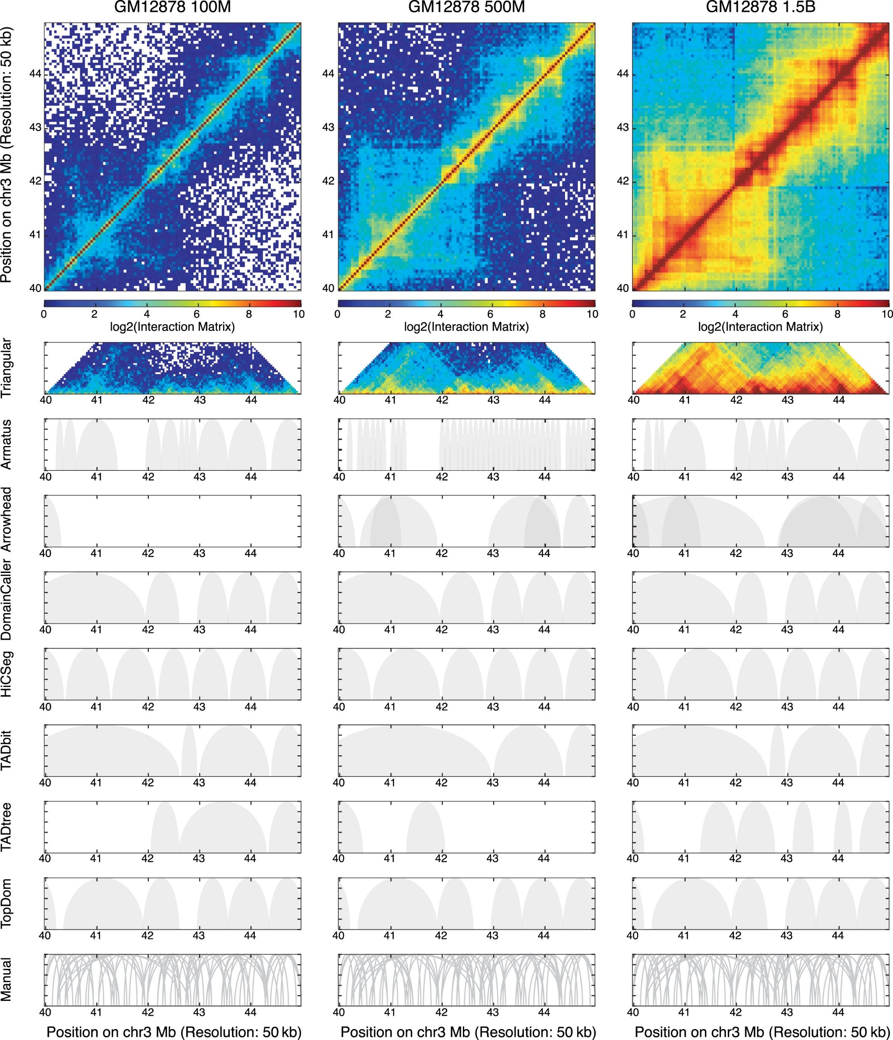
Choosing the TAD caller: TopDom
Notes:
From A critical assessment of topologically associating domain prediction tools

Slide 31
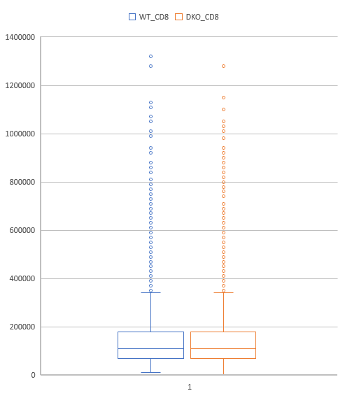
Call TADs with Resolution 10k
Average_TAD_Size = 142kb
# of TADs =17,287
Windows Size = 5
Average_TAD_Size = 142kb
# of TADs = 17,311
Windows Size = 5

Slide 32
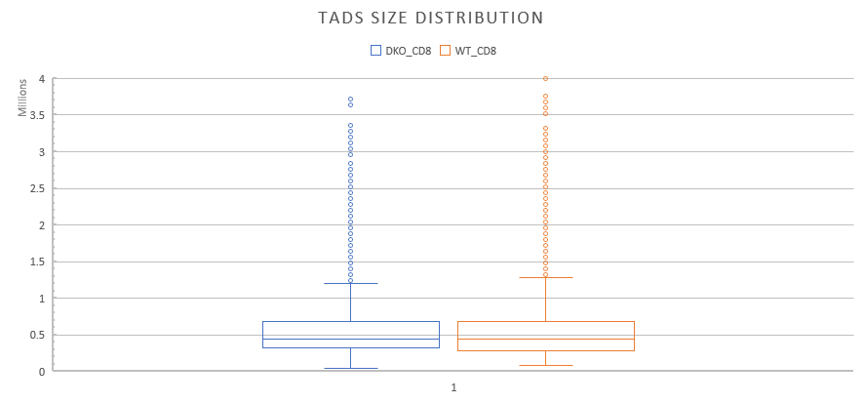
Call TADs with Resolution 40k
Average_TAD_Size = 597kb
# of TADs =4298
Windows Size = 5
Average_TAD_Size = 588kb
# of TADs =4254
Windows Size = 5
Notes:
Rule for the shared one:
At least one base pair overlapped.

Slide 33
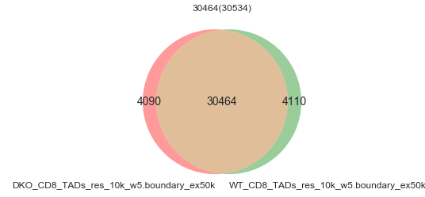
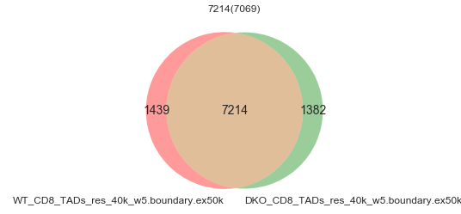
TADs Boundary With 50k Extension
Res=10k
Res=40k
Notes:
XiangLi\Haihui\CD8-HP\Hi-C\TADs/Boudary_Extension_50k

Slide 34
Checking CTCF enrichment at TADs boundary Using reads of CTCF ChIPseq in T Cells
https://www.ncbi.nlm.nih.gov/sra?term=SRX2843858
Sample Name | #raw reads | # Concordantly Exactly 1 time Rate (%) | Overall Alignment Rate(%) | # MACS2 Peaks | # MACS2 filtered Peaks
SRR5585942 | 89,373,298 | 75.57 | 97.74 | 58,466 | 56,260

Slide 35
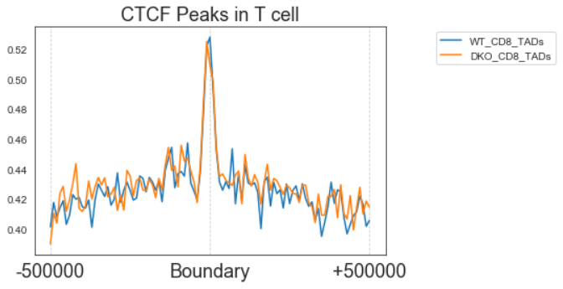
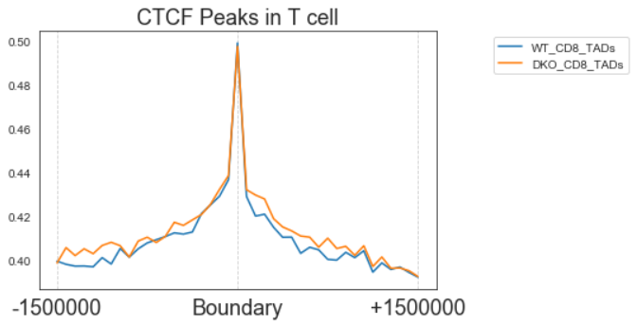

Call TADs with Resolution 10k
Average_TAD_Size = 142kb
# of TADs =17,287
Windows Size = 5
Average_TAD_Size = 142kb
# of TADs = 17,312
Windows Size = 5
Notes:
Rule for the shared one:
At least one base pair overlapped.

Slide 36
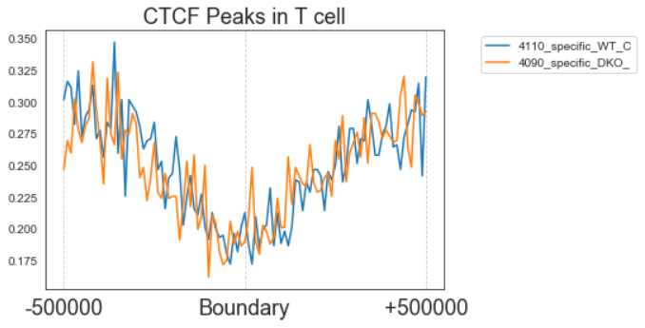
Check CTCF ChIPseq Binding on Diff TADs Boundaries
CTCF Binding decreasing at specific TADs Boundries??
(Almost half of background?)

Slide 37
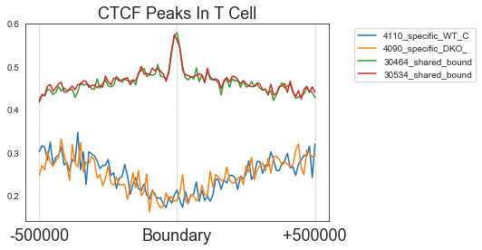
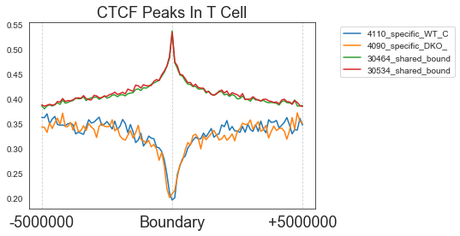
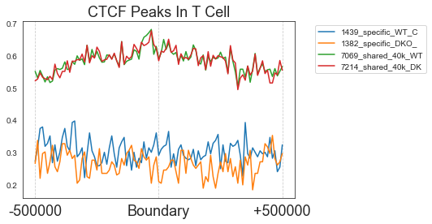
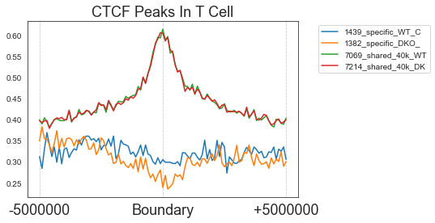
CTCF ChIPseq In T cells
Res 10k
Res 40k

Slide 38
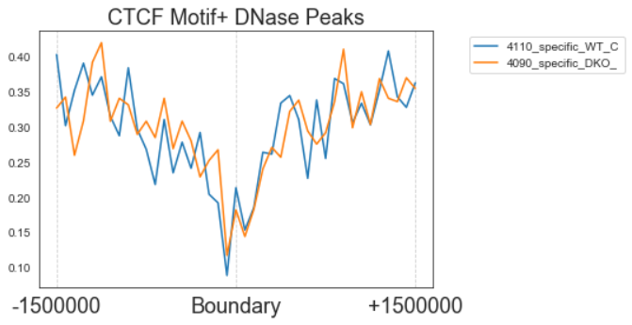
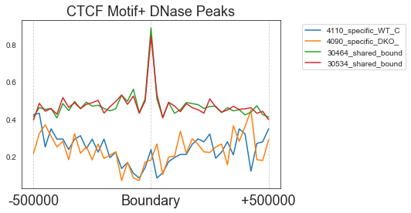
Check CTCF Motif+ Binding on Diff TADs Boundaries
Similar observation found in CTCF Motif+ DNase Peaks

Slide 39
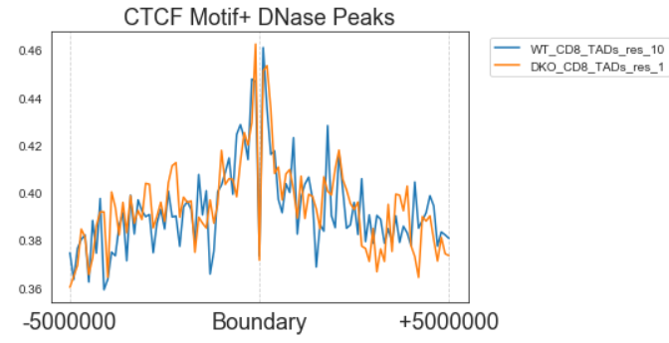
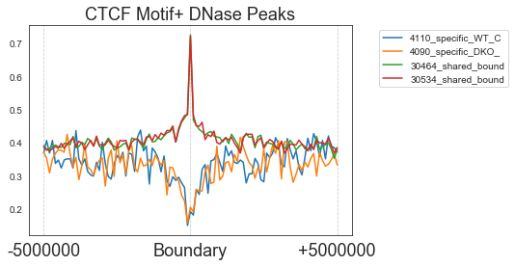
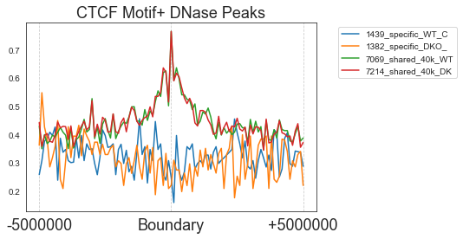
CTCF Motif+ DNase Peaks
Res 10k
TADs Middle Point
Res 40k

Slide 40
Characterization/validation of TADs Checking CTCF enrichment at TADs boundary

Slide 41
From CD8-HP DNase-seq Picard De-Duplication Summary
Read length: 50bps (Trim R1 and R2 with 100 bps from right end)
Bowtie2 was used to align the reads to mouse genome (UCSC mm9 from iGenome for gene annotation)
Sample Name | #raw reads | Union Peaks | # CTCF+ Hits CTCF/MA0139.1/Jaspar(0.909) | # CTCF+ Peaks | # CTCF+ Reads / CTCF- Reads
WT-na1 |  | 25,284 | 2,828 | 2,729 | 168,344/47,110,127
WT-na2
dKO-na1 | 52,632,457 |  |  |  | 111,654/52,520,803
dKO-na2
WT-s1
WT-s2
dKO-s1
dKO-s2
Notes:
Repeat = simple_Repeat+Satellite

Slide 42
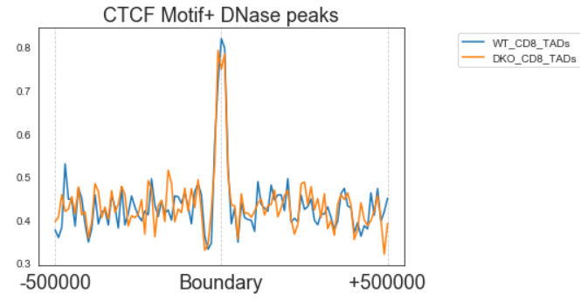
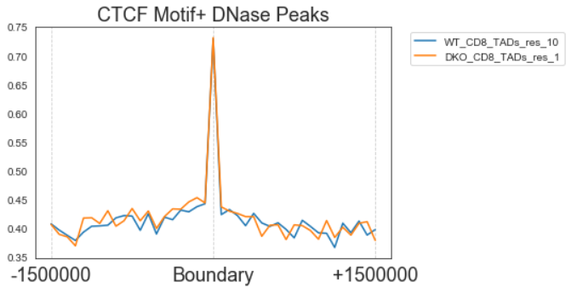
Thought
Previous Plan, identifying diff CTCF Motif+ Site in Dnase peaks between WT / DKO,
Using Union CTCF Motif+ site to draw profiles on boundary of WT/ DKO, to tell is there any difference? (If not, probably not much impact on CTCF Motif?)
34,574 Boundaries for WT
34,622 Boundaries for DKO
2,729 CTCF Motif+ Dnase Peaks

Slide 43
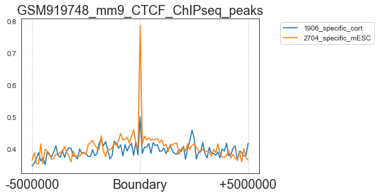
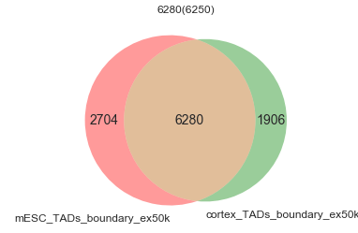
Check on mESC and cortex TADs Boundaries

Slide 44
Procedure
HiCcompare
https://bmcbioinformatics.biomedcentral.com/articles/10.1186/s12859-018-2288-x

Slide 46
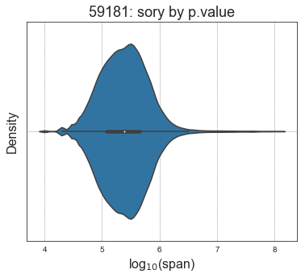
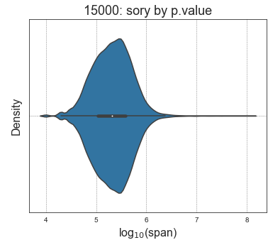
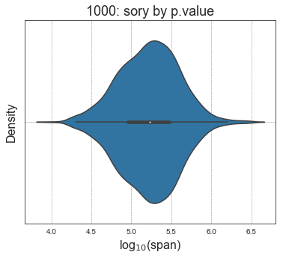
Differential Chromatin interactions span
 | TADs 10k_w5 (17,287) | TADs 40k
Diff_HiC:59,181 | 11,478(19.4%) | 30,805(52.1%)
Diff_HiC: Top15,000 | 3,231(21.5%) | 8,559(57.1%)
Diff_HiC: Top1,000 | 268 | 676

Slide 47
Diff Hic by hiccompare
Diff_HiC_Interaction | Pvalue = 0.01
WT_CD8 vs DKO_CD8 All Pairs | 59,181 (25,531 Up, 43.14%) (33,650 Down , 56.86%)
Pairs Overlap with promoter(19,025) | 19,025 (7,723 Up, 40.59 %) (11,302 Down, 59.40%)
Diff HiC | Up Regulated Genes(313) #_DCI/#_genes | Down Regulated Genes(259) #_DCI/#_genes
7723 Up | 141(105) | 65(55)
11302 Down | 123(92) | 229(134)
 | # of DCI | # of genes | Dnase Gain sites | Dnase Lost Sites | Tcf1 Binding | Tcf1 Direct Binding
Up_HiC_up | 141 | 105 | 3 | 1 | 42 | 13
Up_HiC_down | 123 | 92 | 0 | 2 | 20 | 7
Down_HiC_up | 65 | 55 | 0 | 1 | 15 | 7
Down_HiC_down | 229 | 134 | 1 | 4 | 58 | 22
Notes:
Up 137: Dnase Gain sites: 71 , Dnase Lost Sites:66
Down 329 : : Dnase Gain sites: 47 , Dnase Lost Sites: 282

Slide 48
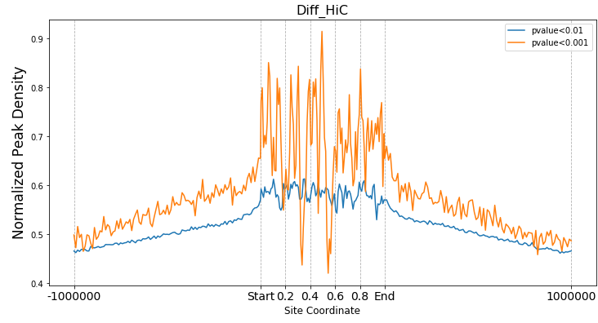
Validation of Diff HiC region
Notes:
Differential regions overlap with CTCF sites
We hypothesized that regions, detected as differentially
interacting, most likely represent biologically relevant
boundaries of topologically associated domains changing
between two conditions. As such, we investigated
whether differentially interacting regions are enriched in
CTCF binding sites, an insulator protein known to bind
at TAD boundaries [28]. To test that, we compared
Hi-C data from GM12878 and K562 cell lines at 100 MB
resolution using HiCcompare. A total of 2365 interactions
were identified as interacting differentially (FDR <
0.05) which represented 2783 distinct 100 KB genomic
regions. We found that a total of 130,675 CTCF binding
sites overlapped with these regions. The amount of overlaps
observed was significant (permutation p-value =
0.002), confirming our hypothesis that the differentially
interacting regions detected by HiCcompare play an import
biological role in chromatin structural organization

Slide 49
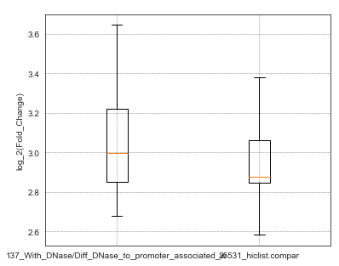
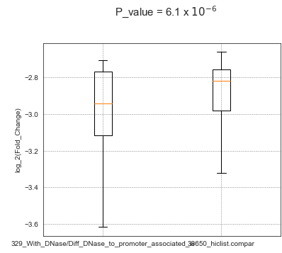
Diff Hic by hiccompare
Diff_HiC_Interaction | Pvalue = 0.01
WT_CD8 vs DKO_CD8 All Pairs | 59,181 (25,531 Up, 43.14%) (33,650 Down , 56.86%)
Pairs Overlap with Tcf1(19,042) to promoter | 5,846 (2,364 Up , %) (3,482 Down, %)
Pairs Overlap with Diff_DNase(1,551) to promoter | 466 (137 Up) (329 Down)
Pairs Overlap with Dnase_Union(36,380) to promoter | 9902 (3988 Up) (5914 Down)
Diff HiC | Dnase Gain sites | Dnase Lost Sites | Up Regulated Genes | Down Regulated Genes
137 Up (124 genes) | 71 | 66 | 3 | 1
329 Down (307 genes) | 47 | 282 | 2 | 5
Notes:
Up 137: Dnase Gain sites: 71 , Dnase Lost Sites:66
Down 329 : : Dnase Gain sites: 47 , Dnase Lost Sites: 282

Slide 50
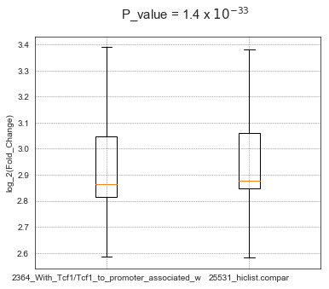
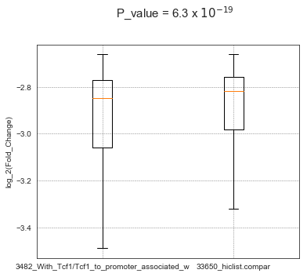
Diff Hic by hiccompare
Diff_HiC_Interaction | Pvalue = 0.01
WT_CD8 vs DKO_CD8 All Pairs | 59,181 (25,531 Up, 43.14%) (33,650 Down , 56.86%)
Pairs Overlap with Tcf1(19,042) to promoter | 5,846 (2,364 Up , %) (3,482 Down, %)
Pairs Overlap with Diff_DNase(1,551) to promoter | 466 (137 Up) (329 Down)
Pairs Overlap with Dnase_Union(36,380) to promoter | 9902 (3988 Up) (5914 Down)
Notes:
DKO_na/WT_na, fc>1, M >0 Up: 2364 > 1708 genes
DKO_na/WT_na, fc<1, M <0 Down: 3482 > 2388 genes
Pairs Overlap with Tcf1(19,042) + Diff_Dnase(1,551)
5,417
(2,694 Down, 49.7%)
(2,710 Up , 50.3%)

Slide 51
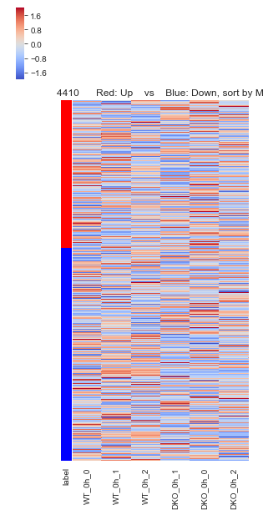
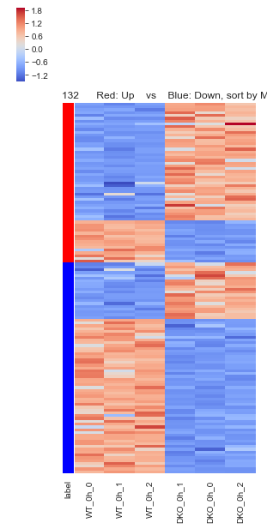
From Tcf1 Binding site to Promoter Diff HiC sites
Up_Gene: 42
Down Gene: 15
Associated With Differential Expressed Genes
(Down_Regulated: 259
Up_Regulated: 313)
Up_Gene: 20
Down_genes: 55
Notes:
DKO_na/WT_na, fc>1, M >0 Up: 2364 > 1810 genes (Up_Gene: 42 Down Gene: 15)
DKO_na/WT_na, fc<1, M <0 Down: 3482 > 2600 genes (Up_Gene: 20, Down_genes: 55)
4410 -> 3786 unique genes,
4410 -> ( 4278 NO_DEGs 70 Down_genes, 62 Up_Genes)

Slide 52
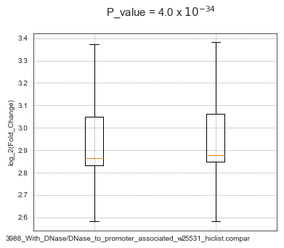
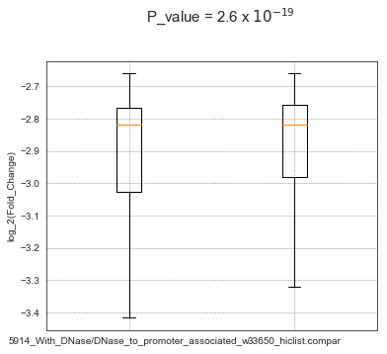
Diff Hic by hiccompare
Diff_HiC_Interaction | Pvalue = 0.01
WT_CD8 vs DKO_CD8 All Pairs | 59,181 (25,531 Up, 43.14%) (33,650 Down , 56.86%)
Pairs Overlap with Tcf1(19,042) to promoter | 5,846 (2,364 Up , %) (3,482 Down, %)
Pairs Overlap with Diff_DNase(1,551) to promoter | 466 (137 Up) (329 Down)
Pairs Overlap with Dnase_Union(36,380) to promoter | 9902 (3988 Up) (5914 Down)

Slide 53
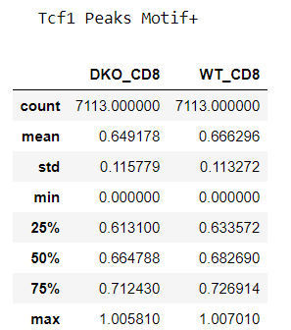
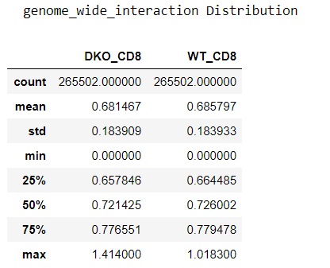
Distribution of Intra-Chromosome Interaction score of bins
Distribution of interaction score of bins, the interaction score of each bin is defined as sum of each row in normalized interaction matrix.
Notes:
Count = Number of bins
Distribution of interaction score of bins, the interaction score of each bin is defined as sum of each row in normalized interaction matrix.

Slide 54
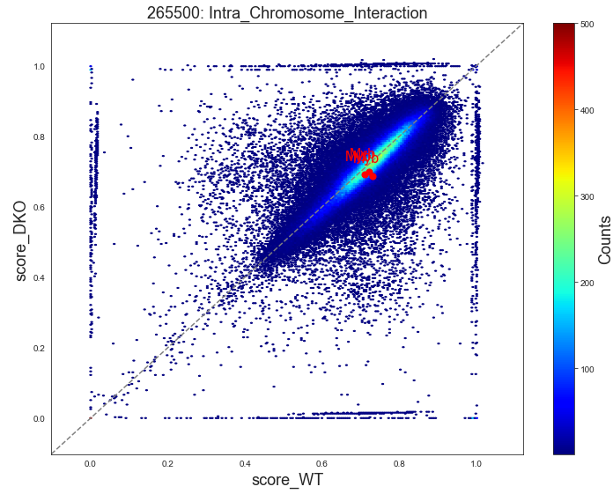
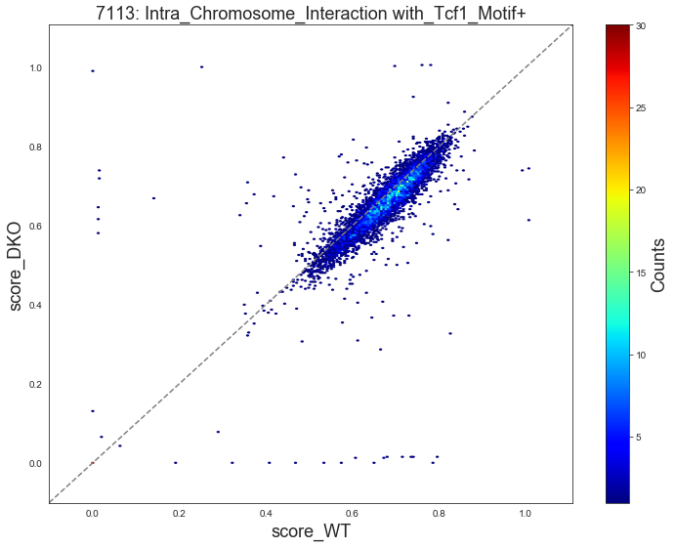
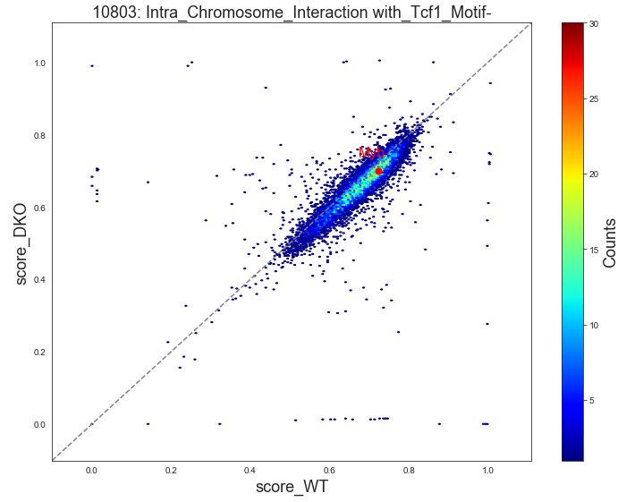
Distribution of Intra-Chromosome Interaction score (Bin Resolution: 10k)
Tcf1+ bins interaction scores show a shift towards WT_CD8

Slide 55
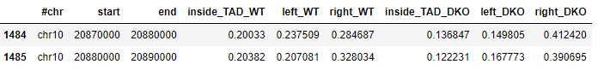
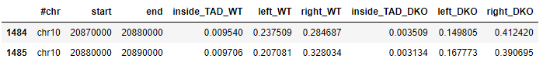
Intra-TADs Interaction
Question:
Since different TADs distribution among different conditions, how to make the comparison of intra-TADs interaction score between them?
An example on Myb Promoter
With Normalization
Notes:
Sum of each row inside a TAD of interaction matrix
(Normalize by TAD length / Resolution(10k) )

Slide 56
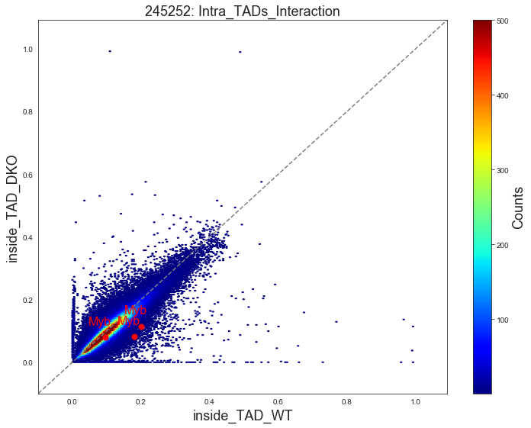





Distribution of Intra-Chromosome Interaction score (Bin Resolution: 10k)
Using WT_TADs
With Normalization

Slide 57




Distribution of Interaction Fold Change
One More Plot 6894+10465, MWU test with 244453,
provide p value for two plots.
Cumulative Plot With Normalization
Cumulative Plot With Normalization
Notes:
All bins with zero interaction score will be replaced by 1/(2^10)

Slide 58


Scatter Plot of interaction score
Notes:
An example of Chr19

Slide 59

Distribution of interaction score fold change from WT-na to DKO-na
Notes:
An example of Chr19
The interaction score equals to zero in both conditions are dropped due for visualization purpose. (Squeezed into a single line around fc=1)

Slide 60


Scatter Plot of interaction score
Interaction score > 0.01
Interaction score > 0.01
Notes:
An example of Chr19

Slide 61



Distribution of interaction score fold change WT-na/DKO-na
Interaction score > 0.01
Notes:
An example of Chr19
The interaction score equals to zero in both conditions are dropped due for visualization purpose. (Squeezed into a single line around fc=1)

Slide 62



Impact of Tcf1 binding on interaction
+Background
Notes:
Chr19

Slide 63






Distribution of Intra-Chromosome Interaction score (Bin Resolution: 10k)
Using WT_TADs
With Normalization
Notes:
Red spot is the bin site of Myb
Promoters[-1k+TSS,TSS+1k]

Slide 64






Distribution of Intra-Chromosome Interaction score (Bin Resolution: 10k) and associated genes with interaction score, fc>3.0
With Normalization
Notes:
Red spot is the bin site of Myb
Gene Associated Rule: -50k+TSS, TES

Slide 65



Reference Example of chromatin accessibility change on Myb
H3K27Ac
Expression

Slide 66



An Example of chromatin accessibility change selected by Intra-TAD interaction with Tcf1 Binding
H3K27Ac
Expression
Notes:
Gramd3

Slide 67


Gramd3

Slide 68
From WT-na to DKO-na significant change on intra_TAD interaction score
Genelist of interests:
Expression Downregulated genes:
Nsg2, Pou2af1, Lef1, Myb
Expression Upregulated genes:
Neat1,

Slide 69
Analysis of AB Compartments
Tool: Juicer eigenvector were used to find AB compartments.
Resolution: 100kb

Slide 70
Prediction of differential compartment
We predicted compartment flip by combining the change in the sign of compartment scores, variation in compartment scores among replicates (Dixon et al., 2015) and dis-similarity of interaction profiles between genomic bins of 20kbp (Lin et al., 2012). We first identified genomic bins with significant variability in compartment scores across all stages by using ANOVA analysis (p < 0.05). Then, we considered only bins where all replicates showed changes in compartment scores from positive to negative or vice versa as candidates of differential bins between any two stages (Dixon et al., 2015); in this analysis, we excluded genomic bins if any replicate-pair from the two stages exhibited similar interaction profiles as determined from their correlation matrices by HOMER (P.C. > 0.6, an indication of similar compartment status) (Lin et al., 2012). From the remaining candidates, we identified those that showed concordant A-to-B compartment flip, namely such a flip occurred between at least two stages, but a B-to-A flip was absent between any two stages, and similarly identified those that showed concordant B-to-A flip. Finally, we merged neighboring candidate bins that shared the same flipping direction to identify genomic regions with concordant A-to-B or B-to-A compartment flip from HSPC to DP cells.
1.Sign Change of Compartment scores
2.Variation in compartment scores among replicates(X)
3.Dis-similarity of interaction profiles between bins.

Slide 71


Preliminary result on AB Compartments

Slide 72

Gene list | Genes Associated with A to B flipping Sites (290) | Genes Associated with B to A flipping Sites (304)
Up_DKO_0h_vs _WT_0h(313) | 1 | 6
Down_DKO_0h_vs _WT_0h(259) | 6 | 1
'Cysltr2', 'Gm8817', 'Gpr137b-ps', 'Lair1', 'Nipa1', 'Rap1gap2'
'Msl3l2', 'Dip2c', 'Prelid2', 'Ppic', 'Stk39', 'Smco4'
Notes:
Heatmap of Union 290 + 304 - 9*2

Slide 73


AB Compartments Flipping
A to B (WT to DKO)
191 Genes
Excluding 99 Genes with No Expression On Both Sides
B to A (WT to DKO)
200 Genes
Excluding 104 Genes with No Expression On Both Sides
Notes:
Fraction of Up, No Change and Down ( Ref: Figure 4.B)

Slide 74


AB Compartments Flipping
B to A (WT to DKO)
200 Genes
Excluding 95 Genes with No Expression On Both Sides
A to B (WT to DKO)
191 Genes
Excluding 100 Genes with No Expression On Both Sides
Notes:
Fraction of Up, No Change and Down ( Ref: Figure 4.B)

Slide 75


AB Compartments Flipping using Differentially Expressed Genes (q_value <=0.05)
A to B
36 Genes
B to A
42 Genes
Gene list | Genes Associated with A to B flipping Sites (290) | Genes Associated with B to A flipping Sites (304)
Up_Regulated(1,658) | 9 | 23
Down_Regulated(1,899 ) | 27 | 19
Up_DKO_0h_vs_WT_0h(313) | Down_DKO_0h_vs_WT_0h(259)
Notes:
P_value

Slide 76


AB Compartments Flipping using Differentially Expressed Genes (q_value <=0.05)
A to B
36 Genes
B to A
42 Genes
Gene list | Genes Associated with A to B flipping Sites (290) | Genes Associated with B to A flipping Sites (304)
Up_Regulated(1,658) | 9 | 23
Down_Regulated(1,899 ) | 27 | 19
Up_DKO_0h_vs_WT_0h(313) | Down_DKO_0h_vs_WT_0h(259)
Notes:
P_value

Slide 77

AB Compartments Flipping using Differentially Expressed Genes (q_value <=0.05)
Gene list | Genes Associated with A to B flipping Sites (290) | Genes Associated with B to A flipping Sites (304)
Up_Regulated(1,658) | 9 | 23
Down_Regulated(1,899) | 27 | 19
Notes:
Fisher exact Test of [ [9, 23],[27, 19] ]

Slide 78
Checking CTCF enrichment at TADs boundary Using reads of CTCF ChIPseq in T Cells
https://www.ncbi.nlm.nih.gov/sra?term=SRX2843858
Sample Name | #raw reads | # Concordantly Exactly 1 time Rate (%) | Overall Alignment Rate(%) | # MACS2 Peaks | # MACS2 filtered Peaks
SRR5585942 | 89,373,298 | 75.57 | 97.74 | 58,466 | 56,260

Slide 79




TADs Validation
Notes:
Resolution 40k, no smooth.

Slide 80




Call TADs with Resolution 10k
Average_TAD_Size = 142kb
# of TADs =17,287
Windows Size = 5
It shows that
Average_TAD_Size = 198kb
# of TADs =10,616
Windows Size = 20
Notes:
Rule for the shared one:
At least one base pair overlapped.

Slide 81


TADs: WT_CD8 Using CTCF ChIPseq Peaks number
Windows Size = 5 (TopDom)
Notes:
Resources of Diff_TAD can be found at \Shared-folder\XiangLi\Haihui\CD8-HP\Hi-C\TADs\

Slide 82


Characterization/validation of TADs with res 40kb
Mean interaction frequencies at all genomic distances between 40kb to 2Mb. Above 40kb, the intra-versus inter-domain interaction frequencies are significantly different (p < 0.005, Wilcoxan test)
Ref: Topological Domains in Mammalian Genomes Identified by Analysis of Chromatin Interactions(https://www.ncbi.nlm.nih.gov/pmc/articles/PMC3356448/)
Average_TAD_Size = 588kb
# of TADs =4254
Windows Size = 5
Notes:
Reference result 1comes from A critical assessment of topologically associating
domain prediction tools, GM12878 or hESC

Slide 83

Checking CTCF enrichment at TADs boundary Using reads on CTCF Motif+ DNase sites
Clear but slow enrichment around 1MB
Apparent enrichment around Boundary

Slide 84

Positive Control: CTCF Peaks Number Distribution on CTCF Motif+ DNase Sites
# CTCF Motif+ Dnase Sites: 2,729
CTCF ChIPseq Data is good
center

Slide 85


CTCF enrichment at TADs boundary in mESC
TADs: TomDom
CTCF ChIP-Seq:
GSM723015
Peak Density
Note the range: +/- 100K
Note the dynamics range: peak 0.9 - valley 0.4
Profile of left boundaries and right boundaries are almost identical.
Why? Reason: Continues TADs in mESC, see next page for example.
Notes:
for LEN in ${Len_Set[*]}; do echo "Extension: $LEN"; Num_l=$(cat mESC_5w.40kb.domain_TSS.bed | awk -v len
=${LEN} '{print $1"\t"$2-len"\t"$3+len"\t"$4}' | bedtools intersect -u -b stdin -a GSM723015_RenLab_CTCF_summits.bed | wc -l); echo $(expr $Num_l - $Num_lo); Num_lo=$Num_l; Num_r=$(cat mESC_5w.40kb.domain_TES.bed | awk -v len=${LEN} '{print $1"\t"$2-len"\t"$3+len"\t"$4}' | bedtools intersect -u -b stdin -a GSM723015_RenLab_CTCF_summits.bed | wc -l); echo $(expr $Num_r - $Num_ro); Num_ro=$Num_r; done

Slide 86

Validation
Notes:
Cutoff has to be the same in two conditions.

Slide 87
Appendix
Epigenome Browser Link:
http://epigenomegateway.wustl.edu/legacy/?genome=mm9&session=wdq0ibJKuT&statusId=582057606 Session: CD8_0319_final
Reference Link:
FastQC V0.11.6 https://www.bioinformatics.babraham.ac.uk/projects/fastqc/
bowtie2 V2.3.4.3 http://bowtie-bio.sourceforge.net/bowtie2/index.shtml
HOMER V4.9.1 homer.ucsd.edu/homer/download.html
Notes:
FastQC v0.11.6
Bedtools V2.27.1
bowtie2 V2.3.4.3
cufflinks V2.2.1
homer V4.9.1
HTSeq V0.6.1
hisat2 V2.1.0
macs2 V2.1.1.20160309
samtools V1.8

Slide 88

Normalization of Hi-C Maps
Notes:
https://gcmapexplorer.readthedocs.io/en/latest/cmapNormalization.html

Slide 89


Slide 90

A comparison about TADs distribution between mESC(reference) and WT_CD8
A continues distribution of TADs will make profile on left and right boundary almost symmetrical.
While a discrete distribution of TADs will dilute the CTCF peak signal on boundary due to asymmetrical effect.

Slide 91


Checking CTCF enrichment at TADs boundary
6 out of 10
2 out of 10
Notes:
All Reads

Slide 92



Checking CTCF enrichment at TADs boundary Using CTCF ChIPseq Peaks number
41 Bins for each profile
Count on Peak number
Smoothing = 6 bins
Y_axis = Number of Peaks per Million peaks per kilobase
CTCF Enrichment appears to be poor at TAD Boundary.
Notes:
All Reads

Slide 93
Question for Zhouhao:
FROM DKO_CD8_run_ICE.py
# generate Juicebox input
for chr1, chr2 in itertools.product(mycooler.chromnames, mycooler.chromnames):
……
'balanced']].to_csv('Juicebox/DKO_CD8_Juicebox_input.txt', sep='\t', index=None, header=None,
……
'balanced']].to_csv('Juicebox/DKO_CD8_Juicebox_input.txt', sep='\t', index=None, header=None, mode='a’)
1. ICE Score vs Non-ICE Score.
Notes:
Question for Zhouhao:
1. /home/zzeng/cloud_research/PengGroup/ZZeng/Data/Haihui/Tcf1/HiC-seq/Combine_Jun_Jul_2016/iterative_mapping_3/Juicebox/ICE_score/DKO_CD8_Juicebox_input.txt.gz source?

Slide 94
Checking CTCF enrichment at TADs boundary using CTCF ChIPseq Peaks number alternative method (Bedtools)
Region | 10000 | 20000 | 30000 | 40000 | 50000 | 60000 | 70000 | 80000 | 90000 | 100000 | 110000 | 120000 | 130000 | 140000 | 150000
Left | 1011 | 939 | 873 | 837 | 804 | 828 | 770 | 740 | 700 | 684 | 672 | 673 | 744 | 640 | 615
Right | 934 | 945 | 961 | 933 | 850 | 843 | 799 | 746 | 720 | 734 | 706 | 693 | 645 | 613 | 553
Combine | 1945 | 1884 | 1834 | 1770 | 1654 | 1671 | 1569 | 1486 | 1420 | 1418 | 1378 | 1366 | 1389 | 1253 | 1168
A discrepancy between profile and “bedtools intersect” exits.
Detail investigation can be found following.

Slide 95
Validation: CTCF peak density at TADs boundary in mESC using Bedtools
Extension: 10000
4079 (left boundaries)
4105 (right boundaries)
Extension: 20000
3744
3800
Extension: 30000
3421
3408
Extension: 40000
2961
2991
Extension: 50000
2610
2604
Extension: 60000
2367
2356
Extension: 70000
2201
2169
Extension: 80000
2048
2039
Extension: 90000
1963
1984
Extension: 100000
1935
1950
TADs: TomDom
CTCF ChIP-Seq:
GSM723015
Notes:
for LEN in ${Len_Set[*]}; do echo "Extension: $LEN"; Num_l=$(cat mESC_5w.40kb.domain_TSS.bed | awk -v len
=${LEN} '{print $1"\t"$2-len"\t"$3+len"\t"$4}' | bedtools intersect -u -b stdin -a GSM723015_RenLab_CTCF_summits.bed | wc -l); echo $(expr $Num_l - $Num_lo); Num_lo=$Num_l; Num_r=$(cat mESC_5w.40kb.domain_TES.bed | awk -v len=${LEN} '{print $1"\t"$2-len"\t"$3+len"\t"$4}' | bedtools intersect -u -b stdin -a GSM723015_RenLab_CTCF_summits.bed | wc -l); echo $(expr $Num_r - $Num_ro); Num_ro=$Num_r; done

